Slide 1
Control Configuration Selection for Integrating Processes Using Graphs
Miguel Castaño Arranz Post-doctoral researcher
Wolfgang Birk Professor
Luleå University of Technology

Slide 2
Outline
Industrial Background
Control Configuration Selection Using Weighted Graphs
Adaptation for Integrating Systems
Case Study: a Secondary Heating System
Conclusions

Slide 3
Industrial Background

Slide 4
A complex process: Making paper
Long and complex process: from virgin and recycled fibers to paper.
Large production volumes (50 ton paper/hour).
Energy intensive process.
1500 control loops for a control engineer.
Complex dynamics:
Many storage vessels (integrators)
Return flows (feedback)
Quickly shifting production targets.
Due to time and cost constrains, it is not often possible to use complex control strategies.
Simple and heuristic design methods are preferred.

Slide 5
Control Configuration Selection Using Weighted Graphs

Slide 6
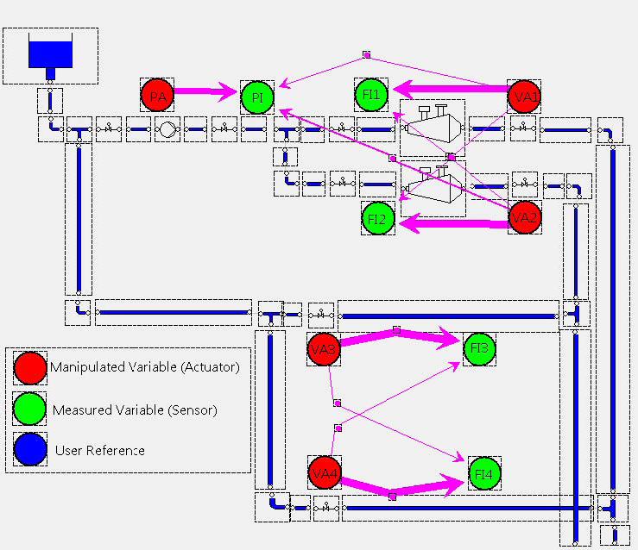
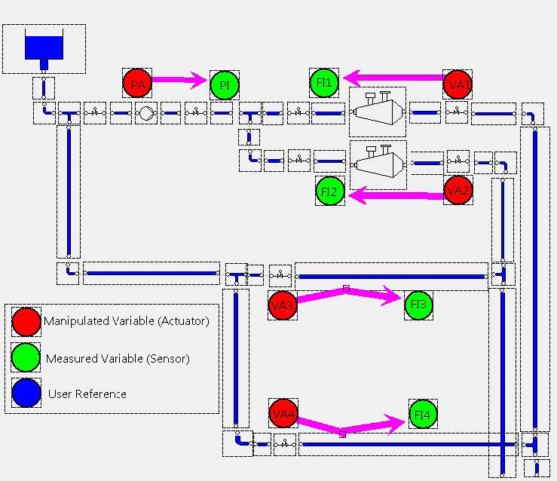
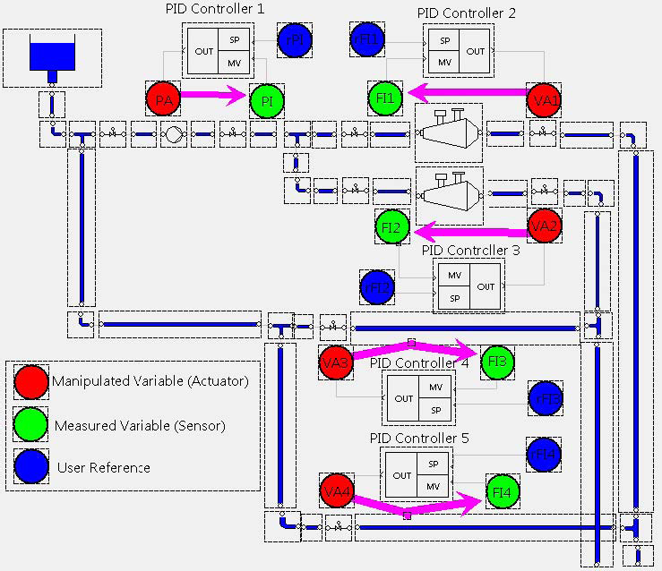
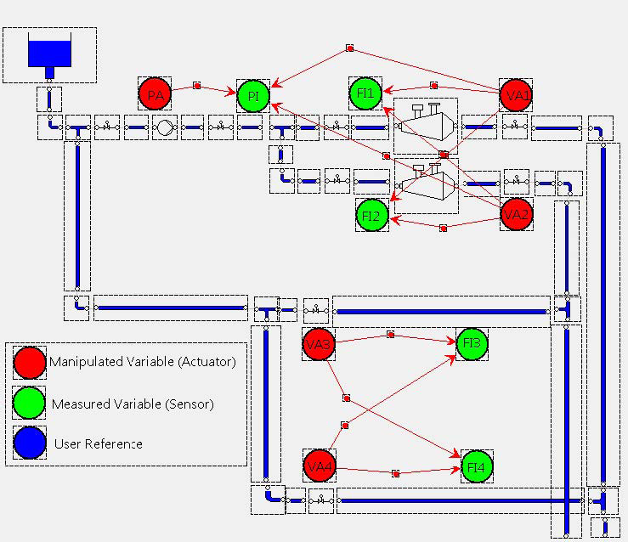
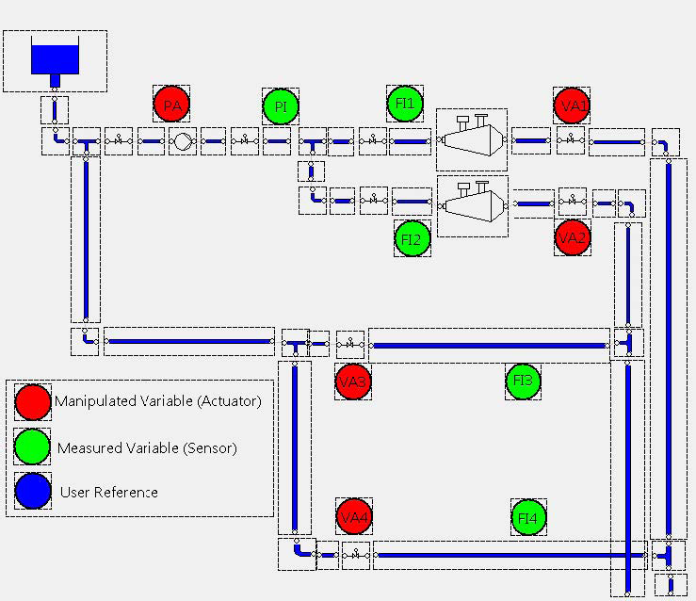
A procedure for control design in complex processes
Subset of sensors and actuators
Model structure
Model
Control Configuration
Performance specification
Controller parameters
Implemented controller

Slide 7
Control Configuration Selection Using Weighted Graphs
The graphs indicate how to group each actuator with a set of measurements used to calculate the control action.
Give easy-to-grasp indications.
Large scale systems have to be first decomposed in segregated units.
Simple configurations are related to:
- simplicity in the design,
- efficient implementation and maintenance,
- robustness to uncertainties and plant failures.
Complex configurations are related to higher achievable performance.
There is a trade off between simplicity and achievable performance.

Slide 8
Selecting Control Configurations Based on Channel Significance
Sparse Controller
Plant
r
+
e
u
y
-
To achieve a diagonal sensitivity function, the structure of the controller matrix has to be the inverse of the structure of the plant matrix.
With the help of the H₂-norm, we choose the structure of the controller matrix to be sufficiently close to the inverse of the structure of the plant matrix.

Slide 9
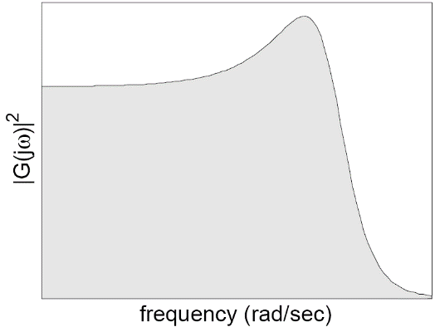
Quantifying the Impact of Actuators on Sensor Measurements
The H₂-norm can be used to quantify the importance of the input-output channels of a multivariable system due to its interpretations in terms of:
- Output controllability.
- Signal energy conversion from input to output.
The H₂-norm can be calculated from the area under the squared magnitude of the subsystem.
For a multivatiable system, those input-output channels with a larger value of the H₂-norm will form a reduced model on which control will be based.

Slide 10
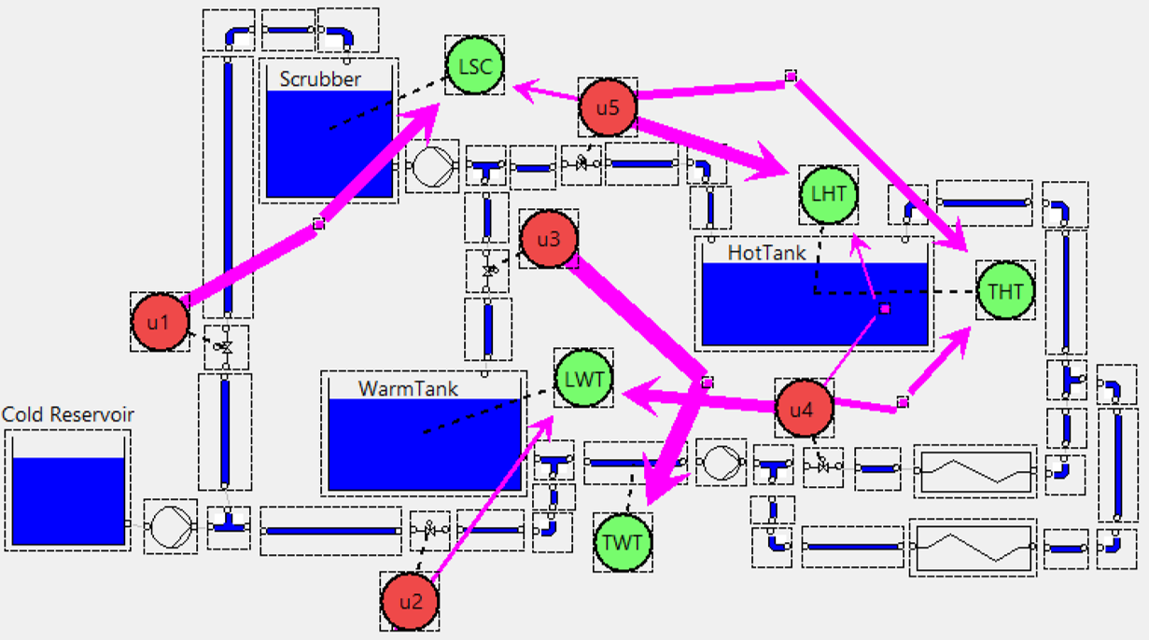
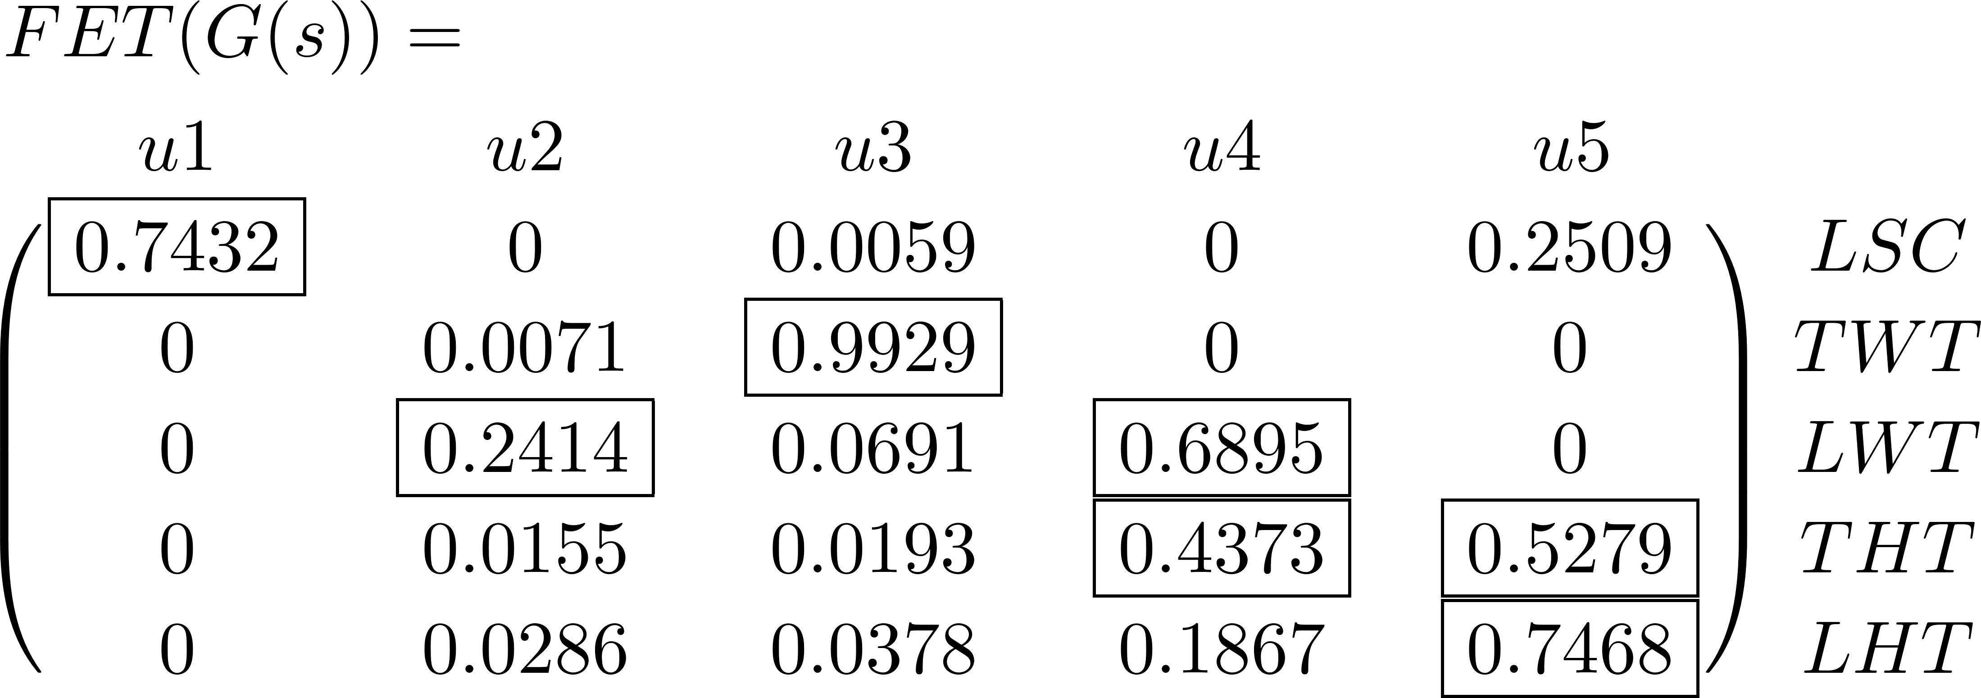
Graphs for Control Configuration Selection based on H₂-norm
Functional Energy Transfer (FET)
FET is a normalization in which all the contributions in the same row add up to 1
FET can be translated to a weighted graph for increased understanding.
Note: only most significant edges depicted

Slide 11
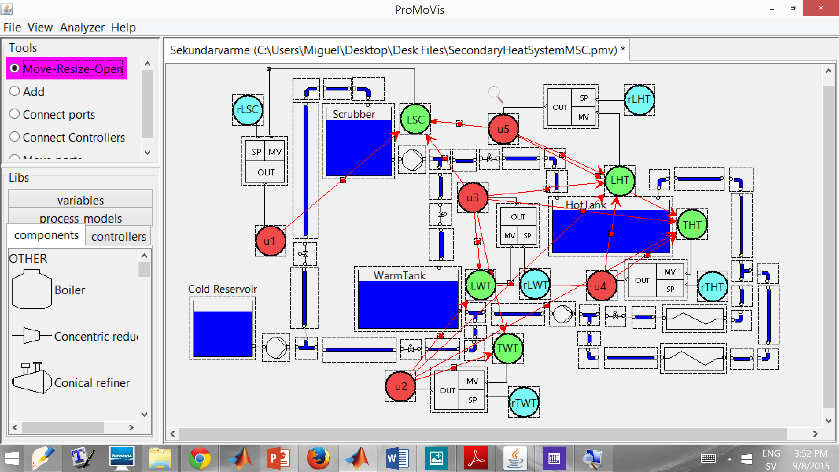
ProMoVis: a Software Tool for Control Configuration Selection
ProMoVis is open source: http://sourceforge.net/projects/promovis/

Slide 12
Adaptation for Integrating Systems

Slide 13
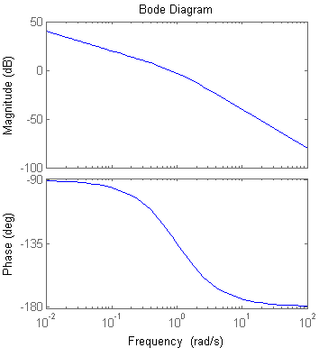
The H₂-norm and Integrating Systems
Problem calculating the H₂-norm for systems with integrators
The following integral doesn’t converge due to the infinity DC-gain
Integrators are often present at industry processes, e.g. at storage vessels.
Solution
Make the calculations restricting the integral to a set of frequencies of interest. This leads to the use of the frequency-limited H₂-norm
Weighted graphs can be generated with the use of the frequency-imited H₂-norm.
$$∞$$
f₁=
f₂=

Slide 14
Case Study: A Secondary Heating System

Slide 15
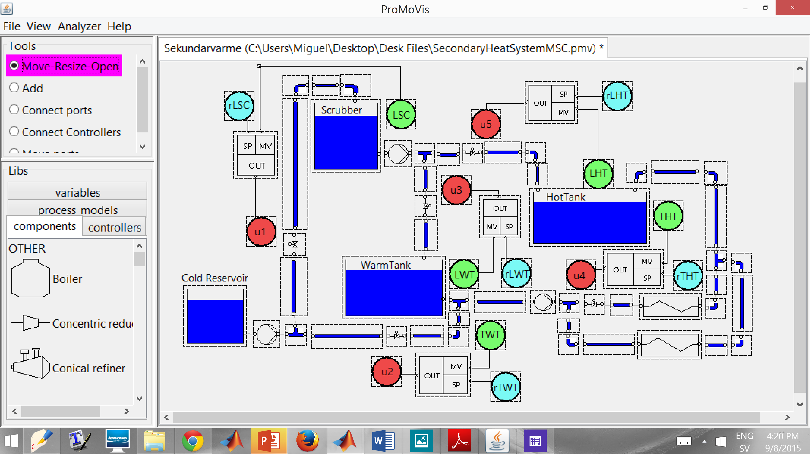
Secondary Heating System
Plant located at BillerudKorsnäs Karlsborg AB.
An efficient secondary heating system reduces dependency on fossil fuel.
Efficient secondary heating has an important impact in costs and environmental impact.
The system exhibited oscillations where the root cause was unknown.

Slide 16
Secondary Heating System: Control Configuration
The figure depicts the control configuration existing prior to our analysis.
This control configuration was designed by experts, based in know-how and acquired process knowledge.
No systematic tool for Control Configuration Selection was used.
Loops are often closed according just to geographical proximity.
u3 is used to control the level of the Warm Tank (LWT), since it commands an incoming flow.
u2 is used to control the temperature at the pipe which exists the Warm Tank, since it drives a flow of cold water directly to the location.

Slide 17
Secondary Heating System: Models
Linear models are first required.
Each red edge represents a SISO transfer function which was modelled using process data.
The model structure was chosen by identifying which actuators have an observable impact in the measurements.

Slide 18
Secondary Heating System: Analysis
?
Note: only most significant edges depicted
U2 -- LWT
U3 -- TWT
Indication n▫ 1: “Warm Tank” should be controlled with the following pairing
The current control scheme has the opposite pairing.
Indication n▫ 2: There is a strong perturbation on the “Warm Tank” coming from u4.
The current control configuration is not considering this perturbation.

Slide 19
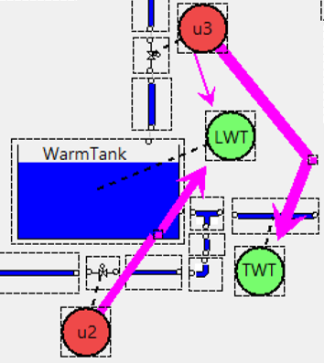
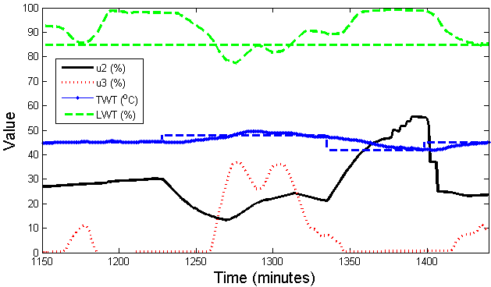
Secondary Heating System: Validation of the Analysis
Analysis results
U2 -- LWT
U3 -- TWT
Indication n▫ 1: “Warm Tank” should be controlled with the following pairing
The current control scheme has the opposite pairing.
LWT
rLWT
rTWT
TWT
Existing configuration
u2
u3
Process experiment at the real plant located in BillerudKornäs Karlsborg AB

Slide 20
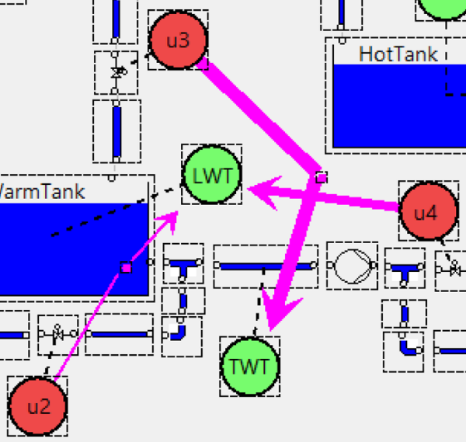
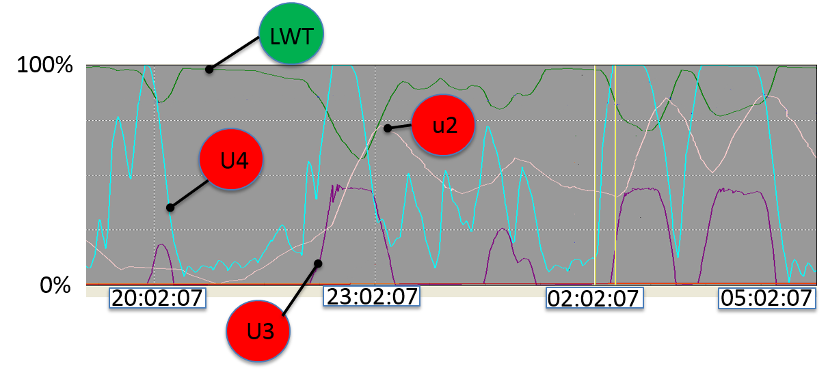
Secondary Heating System: Validation of the Analysis
Analysis results
Indication n▫ 2: There is a strong perturbation on the “Warm Tank” coming from u4.
The current control configuration is not considering this perturbation.
Existing configuration
Data from normal operation of the plant located at BillerudKornäs Karlsborg AB

Slide 21
Conclusions
An extension of a graphic method for Control Configuration selection has been introduced, which can analyze integrating systems.
A case study showed that the method can be used for:
Select feasible control configurations.
Identify causes of deteriorated performance.
The paper compares this method with the Relative Gain Array for integrating systems.
ProMoVis has been upgraded to enable the analysis of systems with integrators.

Slide 22
Questions?
http://sourceforge.net/projects/promovis

