Slide 1
Unsupervised Learning for Subterranean Junction Recognition Based on 2D Point Cloud
Sina Sharif Mansouri, Farhad Pourkamali-Anaraki, Miguel Castaño Arranz, Ali-akbar Agha-mohammadi, Joel Burdick, and George Nikolakopoulos
Sina Sharif Mansouri (sinsha@ltu.se)
PhD Candidate
Luleå University of Technology, Sweden
28th Mediterranean Conference on Control and Automation (MED)
September 16, 2020
Saint-Raphaël, France

Slide 2
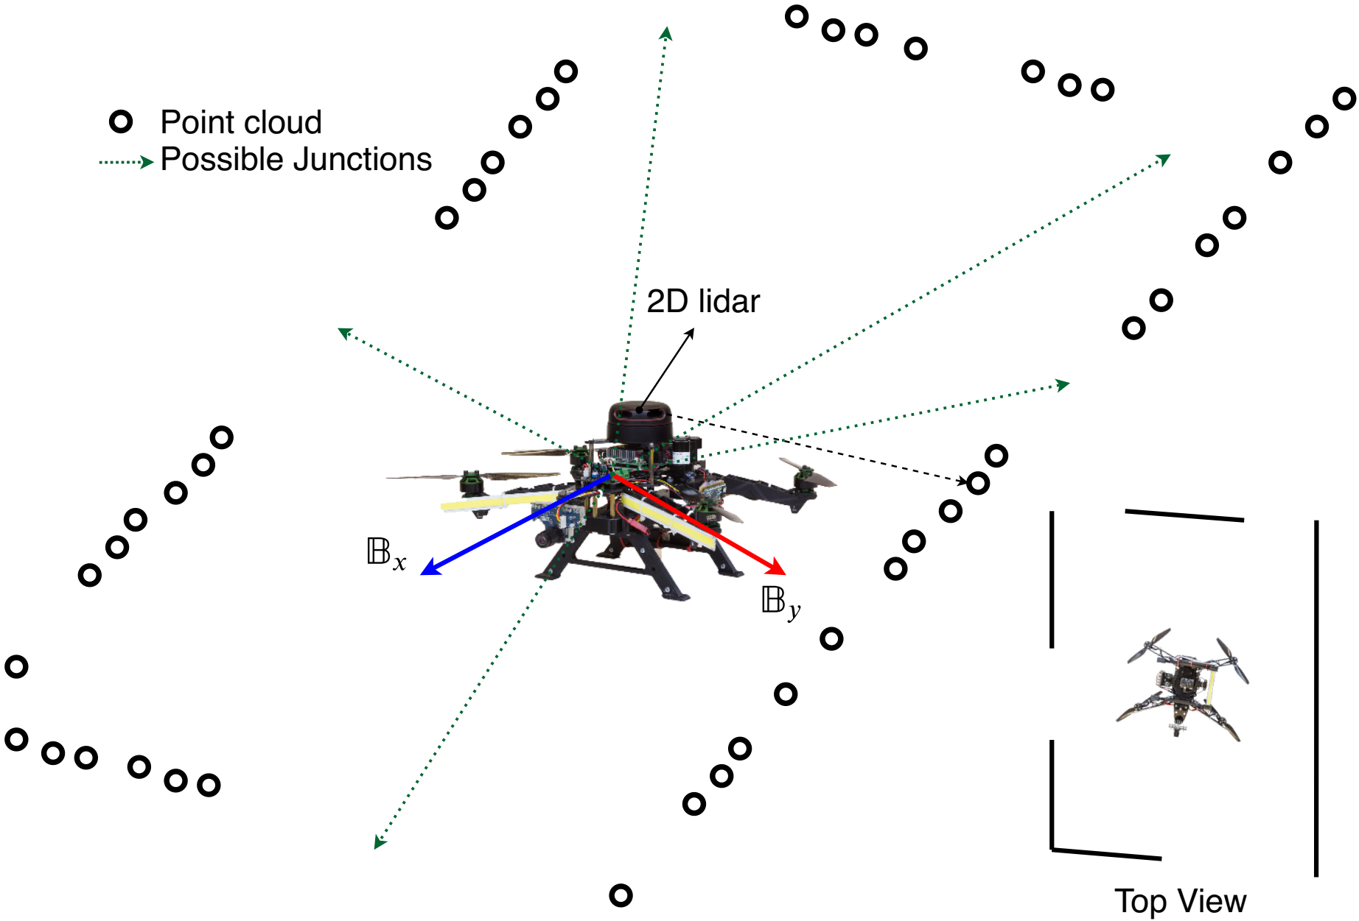
Problem Statement
Integration of the MAVs in inspection and production areas
MAV equipped with sensor suites to autonomously navigate along the tunnel and collect information
These platforms can be considered as consumables that can be instantly replaced

Slide 3
Contributions
Develop a new framework for recognizing subterranean junctions using spectral clustering
The proposed method allows us to uncover intrinsic structures from the 2D point cloud extracted from a lidar.
A comprehensive evaluation of the proposed method in simulation environments with complex geometry and data-sets

Slide 4
Junction Detection
$X∈R^{n×2}$ be a data matrix comprising of n data points
Construct a similarity graph
The matrix $W∈R^{n×n}$ is the adjacency matrix
Use the RBF as a measure of similarity

Slide 5
Junction Detection
For some user-defined σ > 0, we compute the pairwise similarity between $x_{i}$ and $x_{j}$
The next task is to compute a spectral embedding of the original data points $x_{1}, …, x_{n}$

Slide 6
Junction Detection
Form the normalized Laplacian matrix $L∈R^{n×n}$
The eigenvalue decomposition of L provides valuable insights about the structure of the similarity graph
The number of connected components in the graph G is equal to the multiplicity of the 0 eigenvalue.

Slide 7
Junction Detection
k be the estimated number of connected components
we compute the eigenvectors associated with the k smallest eigenvalues of L
we form a new matrix $U∈R^{n×k}$by concatenating these k eigenvectors column-wise
The last step is to perform the K-means clustering algorithm on the non-linearly transformed data points $u_{1}, …, u_{n}$

Slide 8
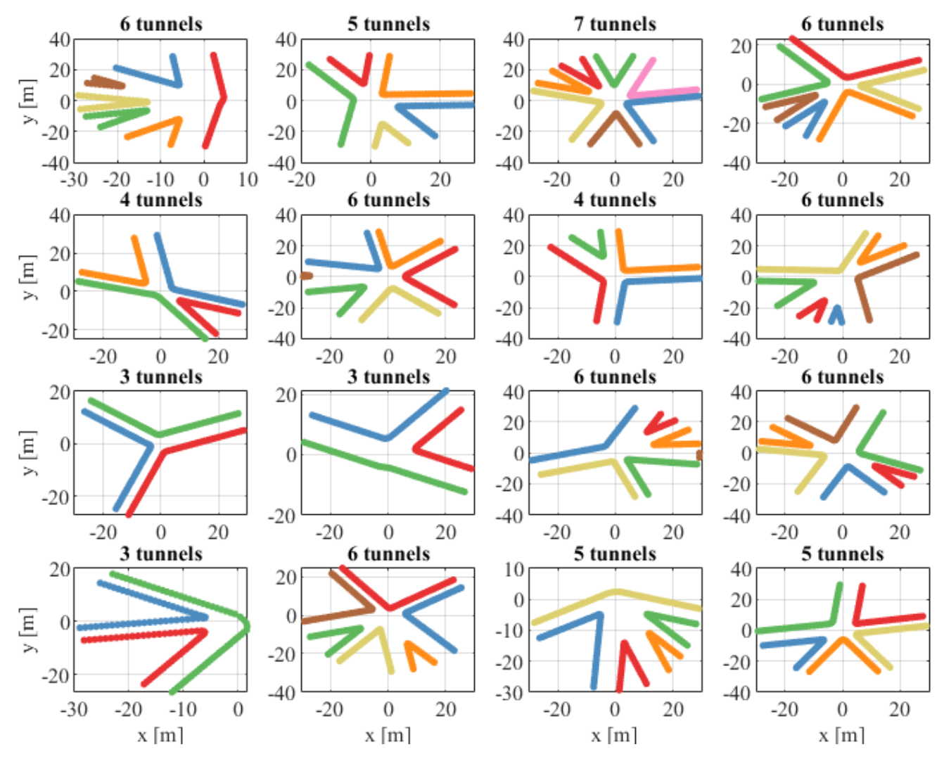
Simulation Evaluations

Slide 9
Experimental Data-sets Evaluations

Slide 10
Experimental Data-sets Evaluations

Slide 11
Thank you! Sina Sharif Mansouri (sinsha@ltu.se)

Slide 12
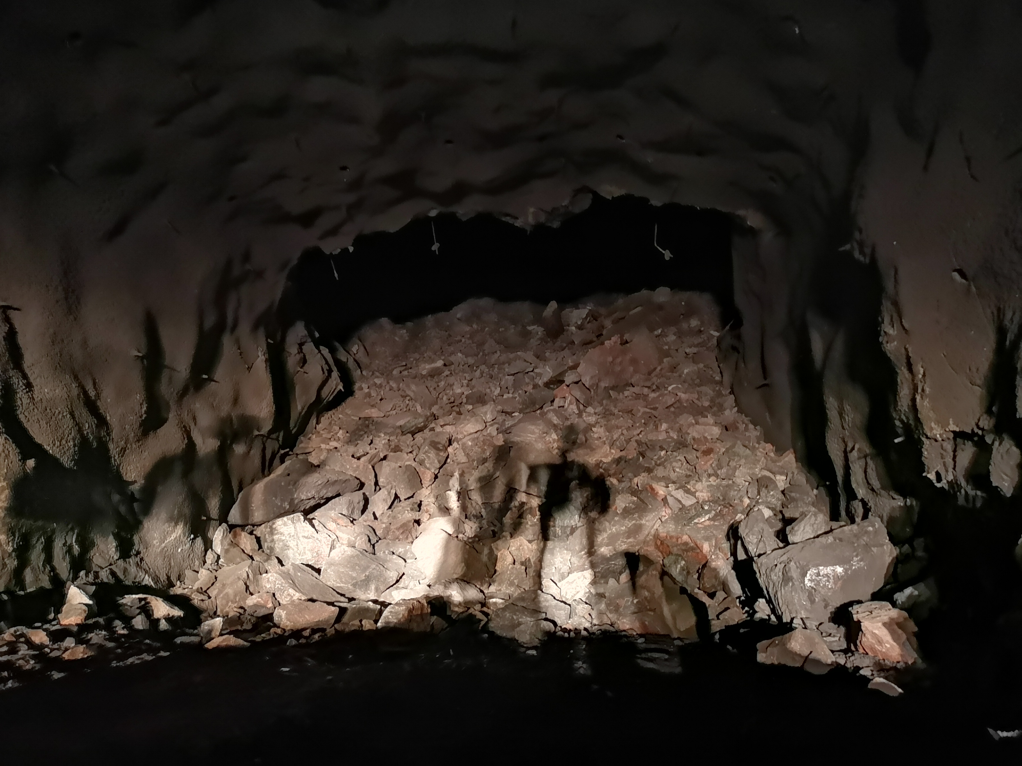
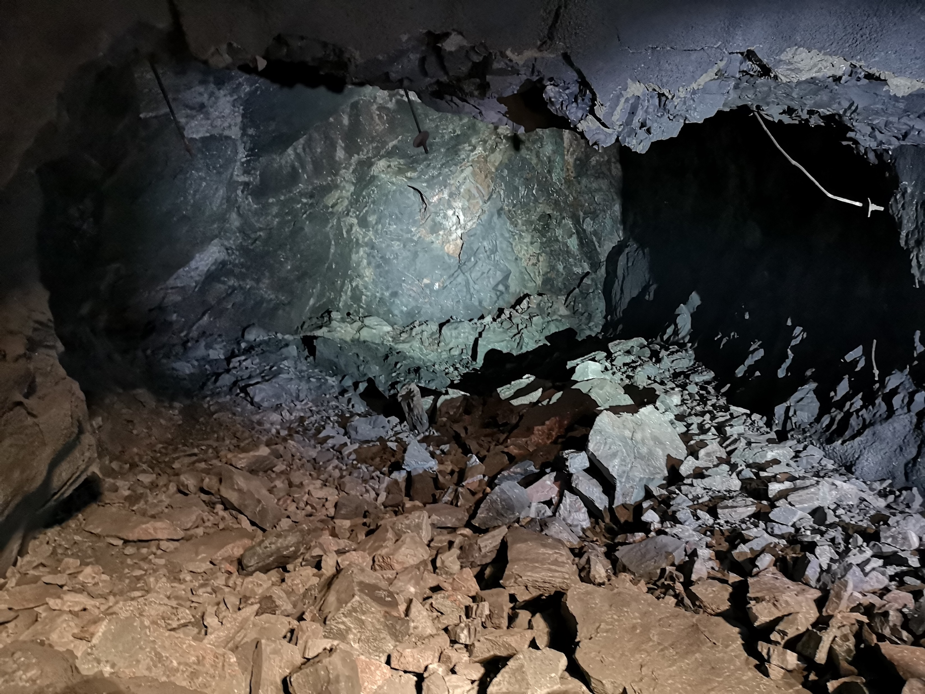
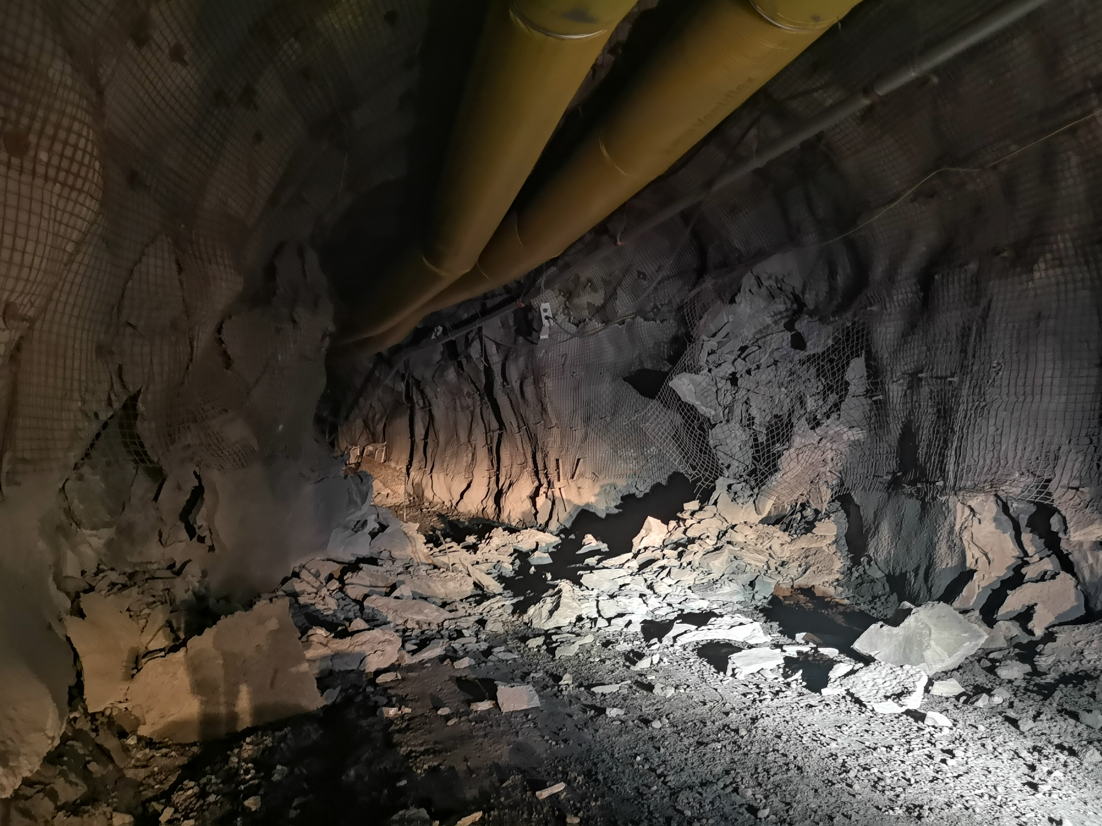
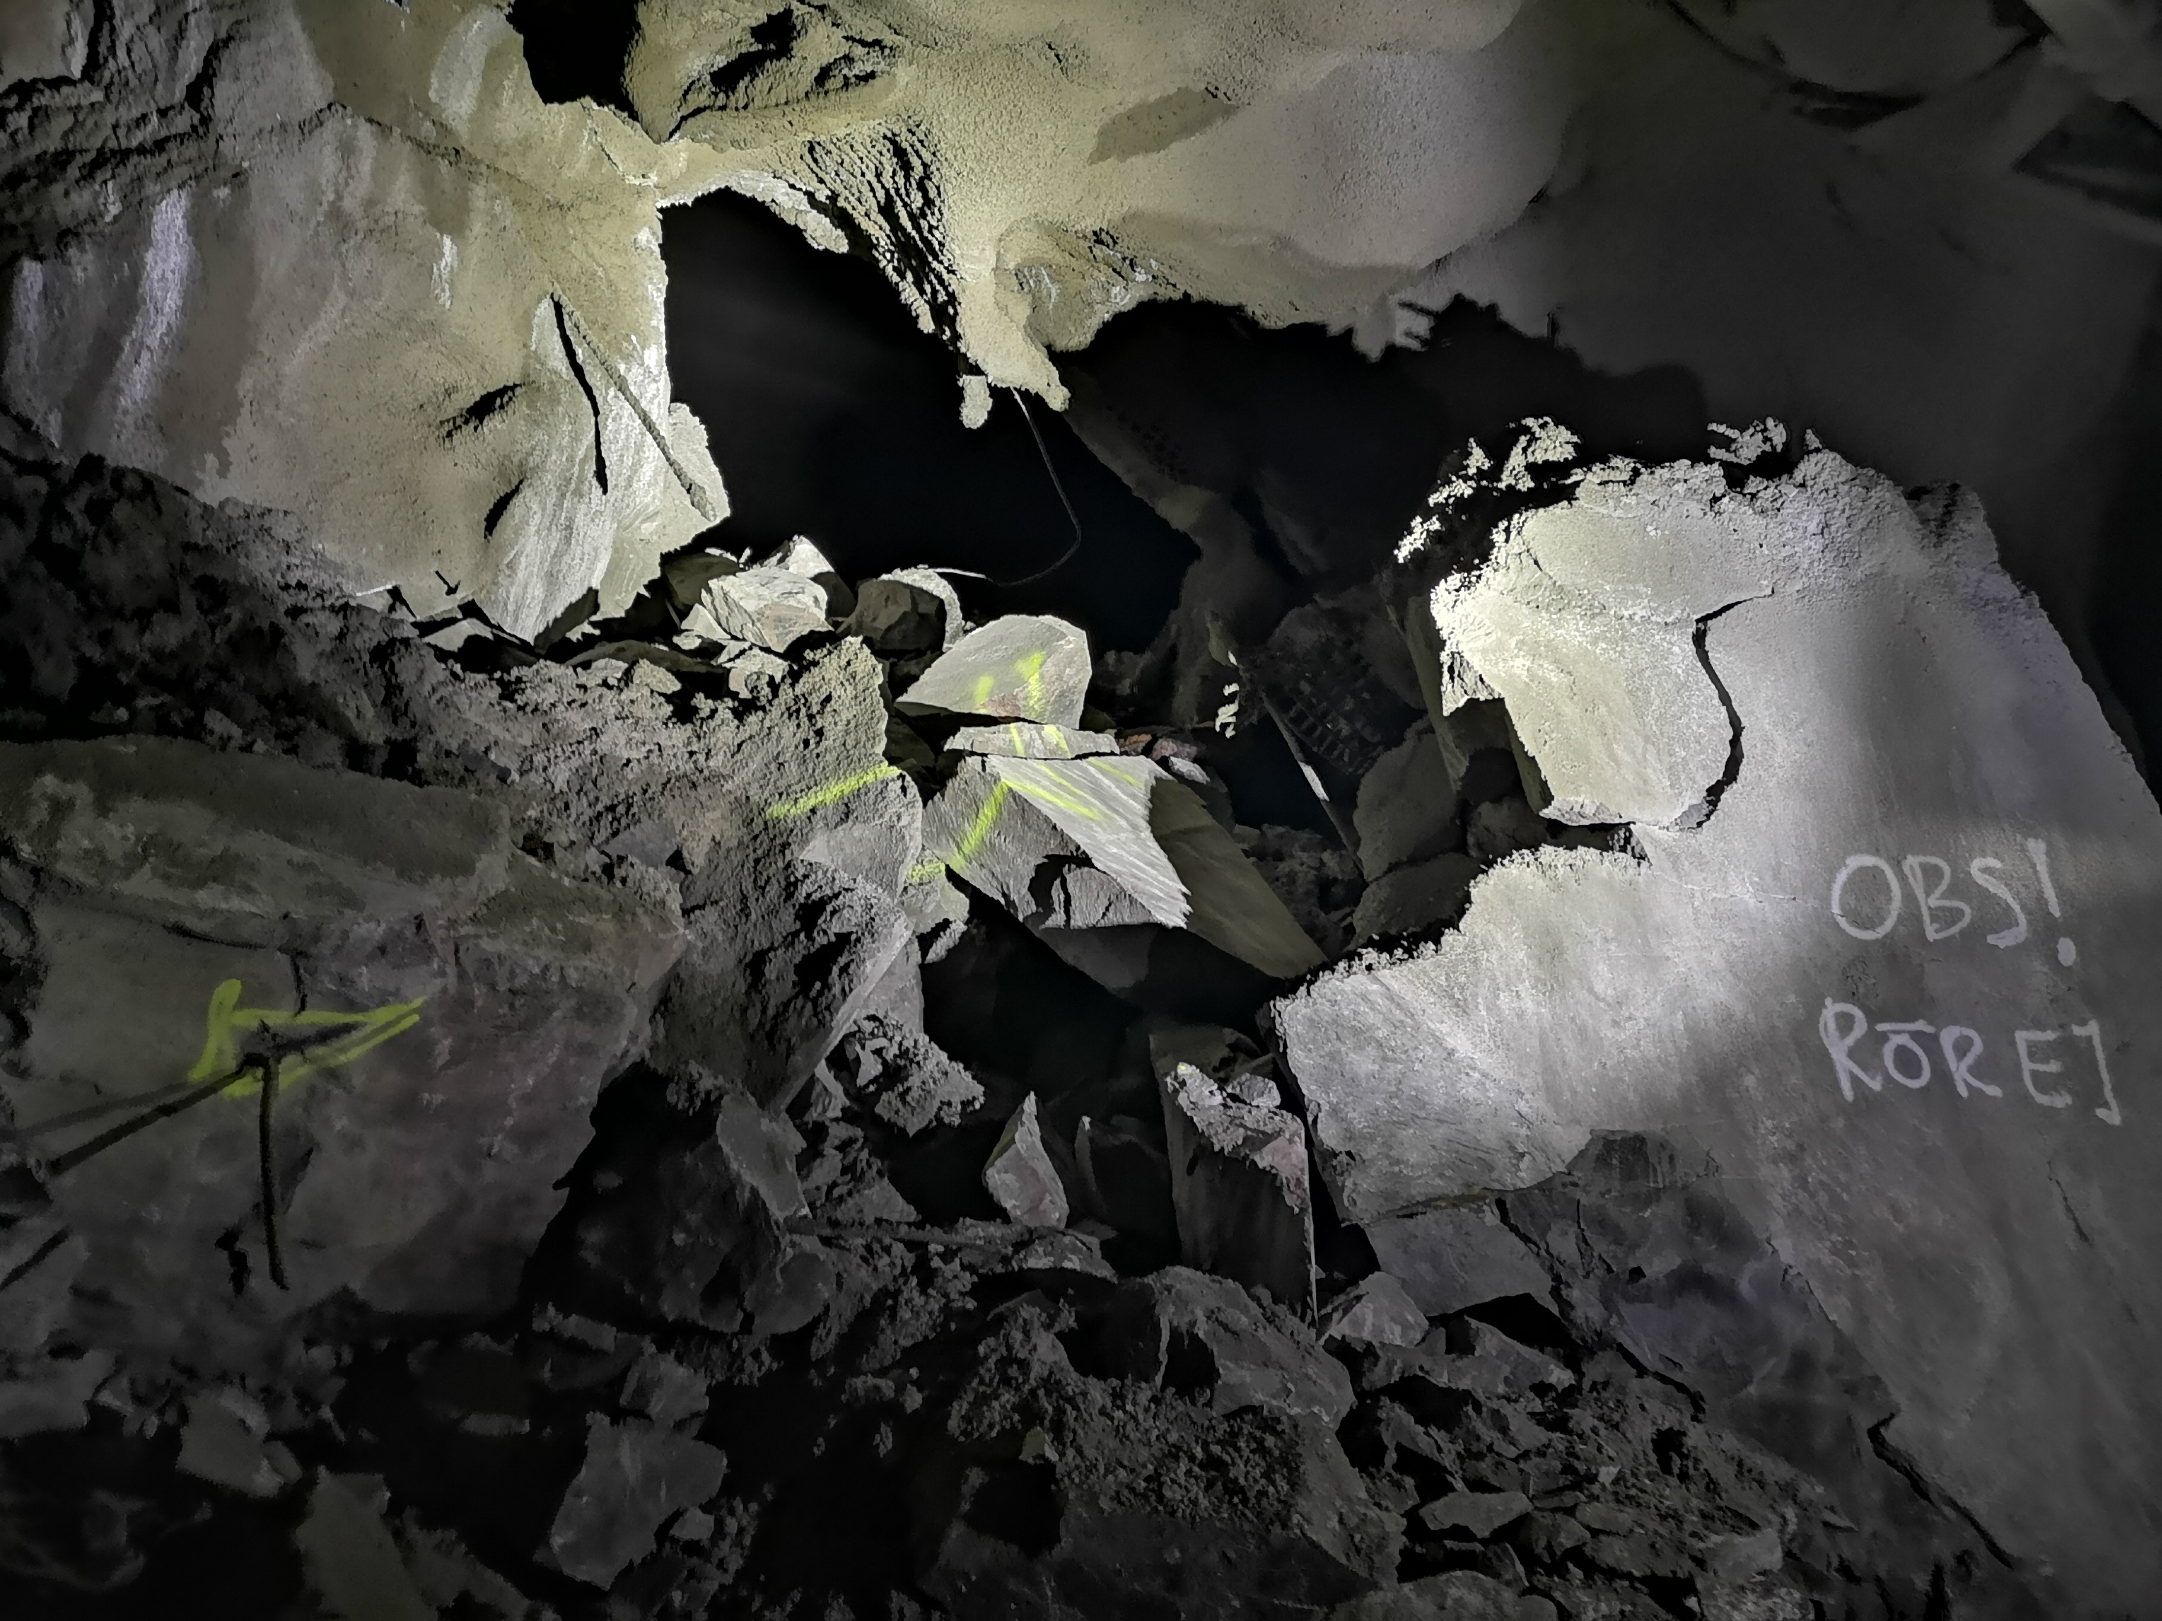
Introduction

Slide 13
State of the Art
Several works have considered the use of visual sensors, lidar, and satellite images for detecting road intersections in uncertain environments [1,2]
Existing methods cannot be used in mines, as the map of such environments is not available
Existing methods are only suitable for certain shapes of junctions
Towards using visual feedback for junction detection, a Convolutional Neural Network (CNN) binary classifier was developed for outdoor road junction detection [3,4]
These methods mostly consider binary classifiers
Most of these works have been evaluated and tuned in out-door environments and with proper illumination
[1] Chen, Z., Liu, C. and Wu, H., 2019. A higher-order tensor voting-based approach for road junction detection and delineation from airborne LiDAR data. ISPRS journal of photogrammetry and remote sensing, 150, pp.91-114.
[2] Negri, M., Gamba, P., Lisini, G. and Tupin, F., 2006. Junction-aware extraction and regularization of urban road networks in high-resolution SAR images. IEEE Transactions on Geoscience and Remote Sensing, 44(10), pp.2962-2971.
[3] Kumaar, S., Mannar, S. and Omkar, S.N., 2018. Juncnet: A deep neural network for road junction disambiguation for autonomous vehicles. arXiv preprint arXiv:1809.01011.
[4] Bhatt, D., Sodhi, D., Pal, A., Balasubramanian, V. and Krishna, M., 2017, September. Have i reached the intersection: A deep learning-based approach for intersection detection from monocular cameras. In 2017 IEEE/RSJ International Conference on Intelligent Robots and Systems (IROS) (pp. 4495-4500). IEEE.

Slide 14
Performance Comparison with DBSCAN

Slide 15
Conclusions and Future Work
We proposed a novel method for the problem of junction detection in subterranean environments
The proposed method uses a non-linear pairwise similarity function to form a graph and find the number of connected components
The proposed method is computationally efficient and detects the number of junctions and walls with average computation time of 0:2 s
The detected walls can be used for wall following methods and number of junctions for local or high level planners
The method is successfully evaluated on multiple random generated 2D point clouds and extracted point clouds from autonomous navigation of the MAV in underground mines

